Slide 1
Introduction to Applied Genomic Epidemiology

Slide 2
Outline
Theory - overlapping timescales of infectious disease transmission and pathogen evolution.
Different applications of genomic data for exploring epidemiologic questions.

Slide 3
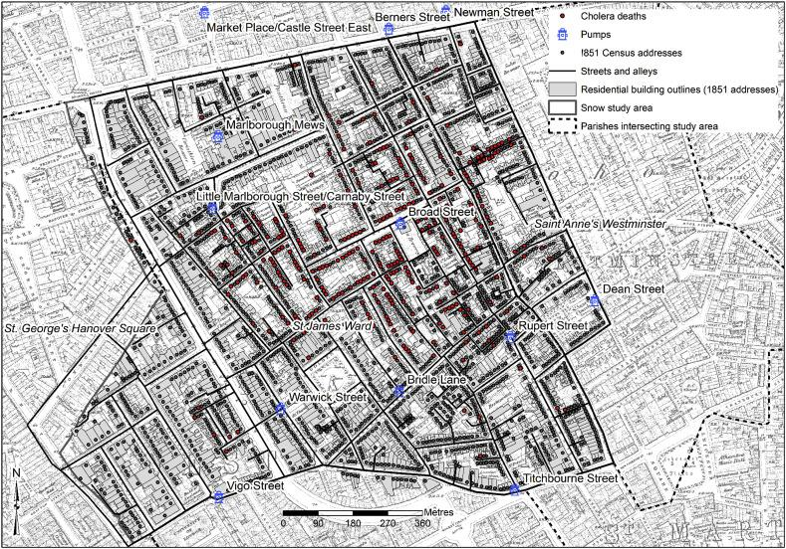
What is epidemiology?
Study of the occurrence and causes of diseases in a population
Questions:
What is it?
Has it been seen before?
How can we fight it?
Is it an outbreak?
Approaches include:
Number of cases of disease in a population e.g., geographic area
The frequency of an exposure among cases and non-cases
Outbreak investigations
Newsom et al. 2006.

Slide 4
Limitations of classical epidemiology
Observations associated with many biases and confounders
Large populations needed for statistical power
Labor-intensive and slow
Often retrospective
Limited information on pathogen circulation dynamics

Slide 5
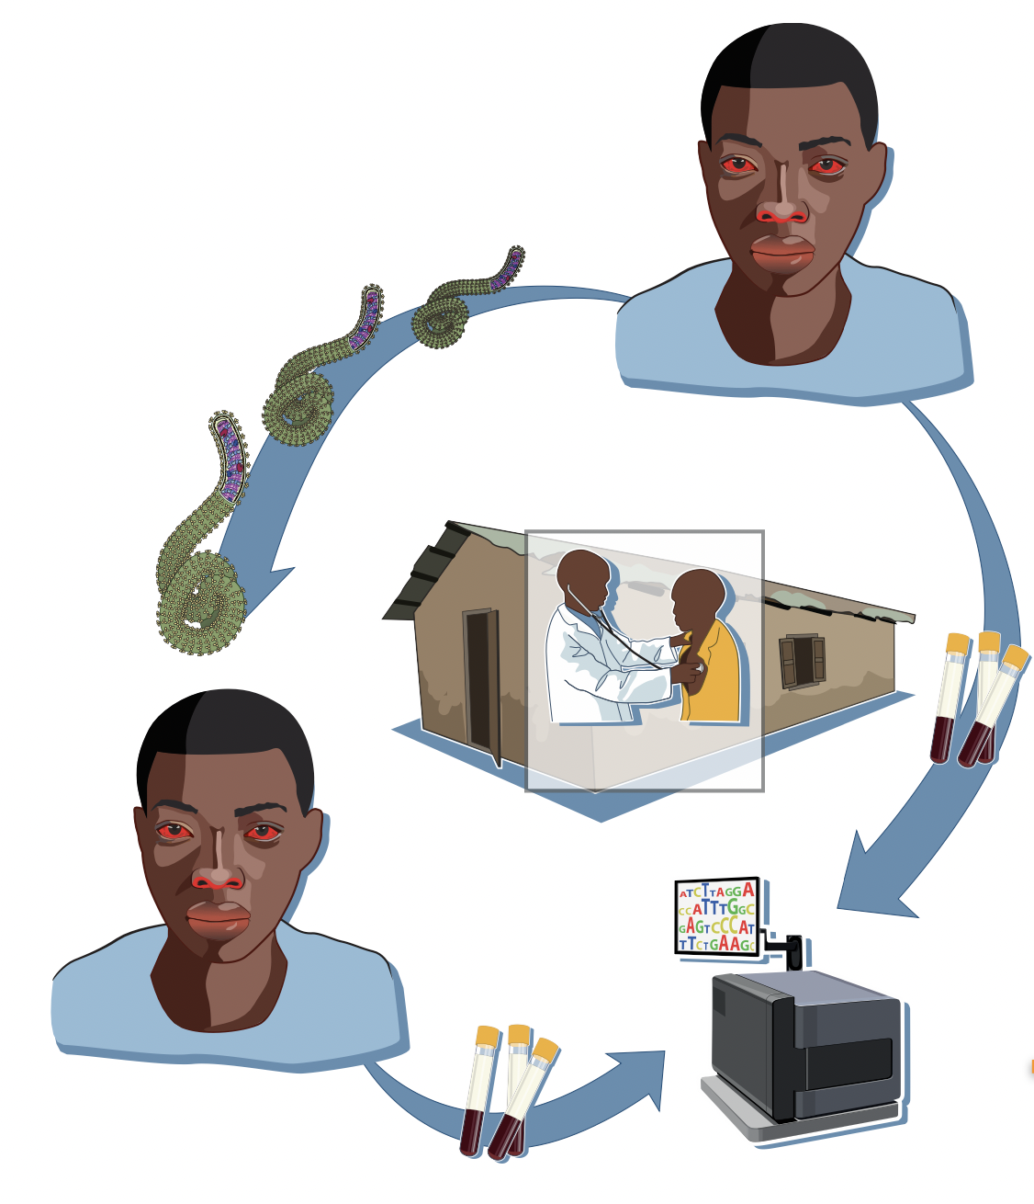
What is pathogen genomic epidemiology ?
Epidemiology of infectious diseases using pathogen sequencing
Sequencing: determining the nucleotide composition of a genome
Genome: the set of genetic information in an organism
Genomic epidemiology is central to infectious disease public health surveillance
Andersen et al. 2015.

Slide 6
Genomic epidemiology is a discipline where we seek to understand the distribution of infectious diseases in a population and determinants of those patterns from pathogen genetic sequence data.

Slide 7
Part 1 - The overlapping timescales of pathogen evolution and infection transmission.

Slide 8
The ability to infer patterns of epidemic dynamics relies on a fundamental principle.
Pathogens evolve and infectious diseases spread through populations on similar timescales.

Slide 9
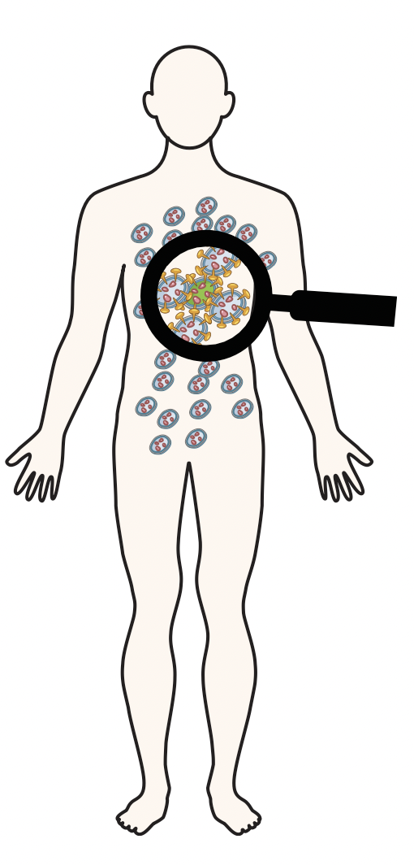
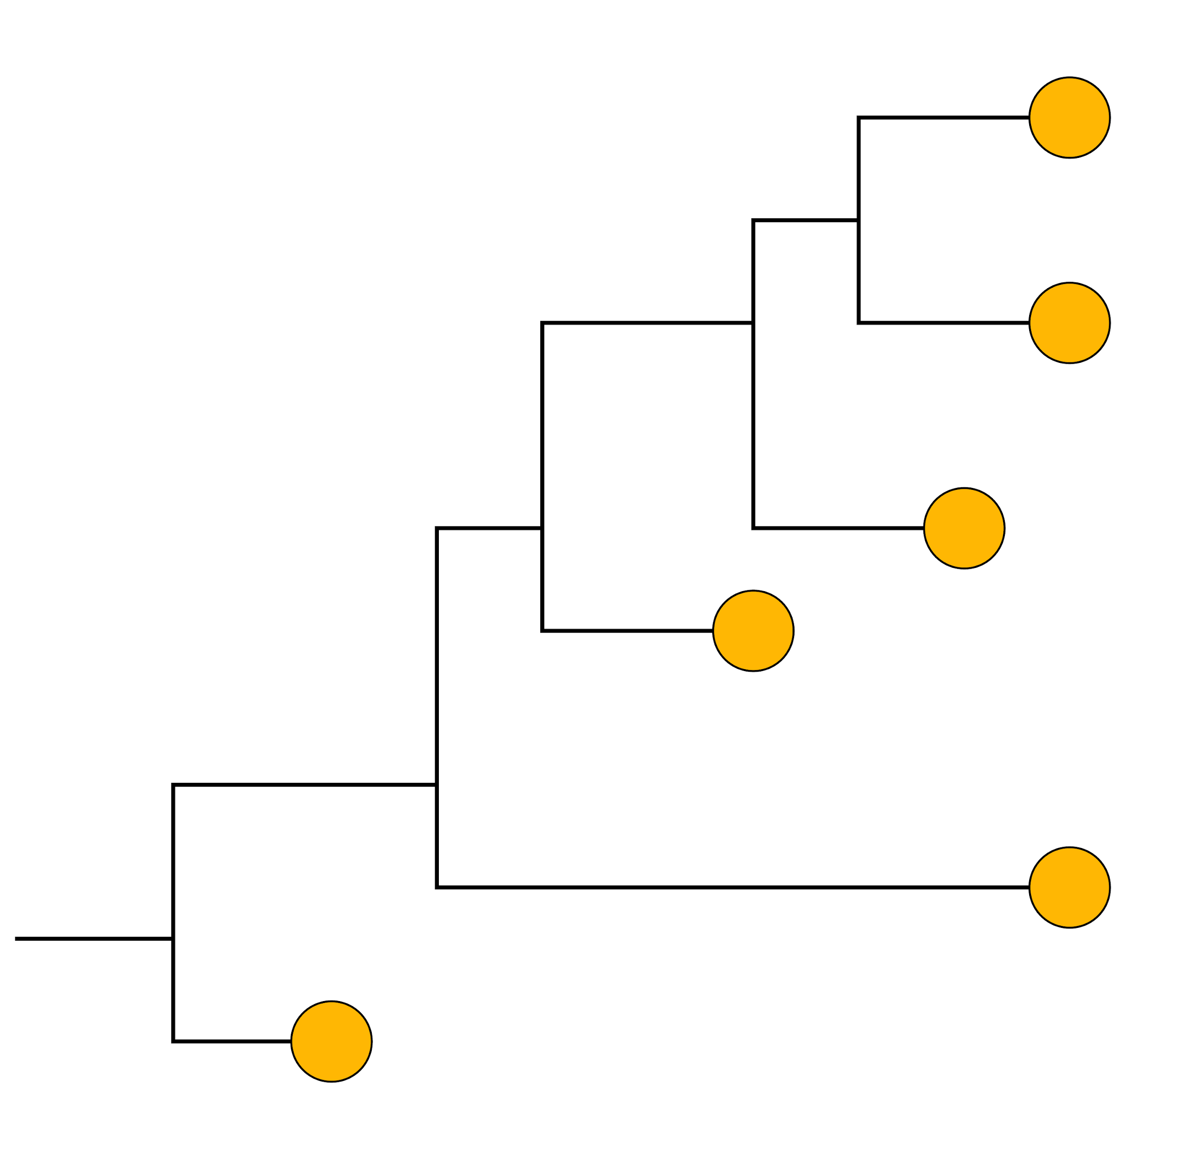


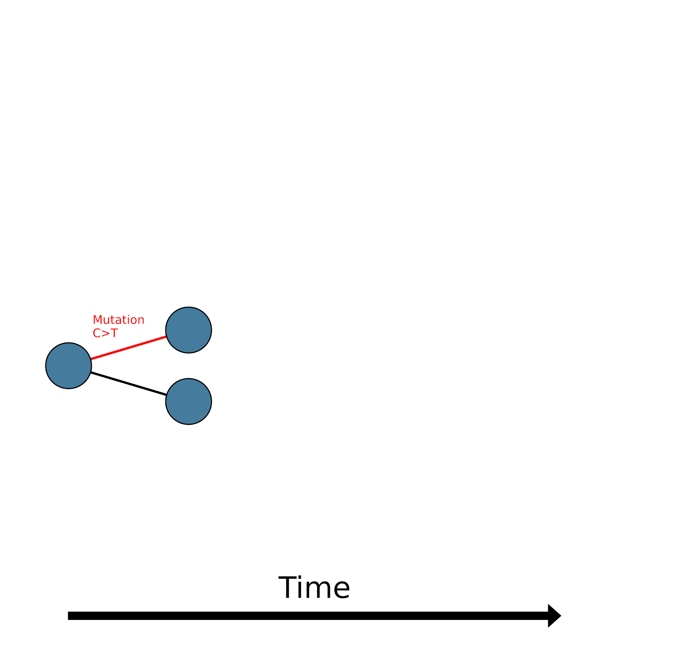



Evolutionary processes play out across multiple scales
Within hosts
Between hosts
Across space
Across time
2005
2005
2005
1995
1993
1990
Short term evolution
Longer term evolution
Time scale?
Time scale?
Notes:
Evolutionary processes happen at different scales
Across time, space, hosts (within and between hosts)

Slide 10
Outbreaks involve transmission between multiple individuals.

Slide 11
First, let’s look at a single individual within this outbreak.

Slide 12
Errors occur during pathogen replication over the course of the infection.
mutation
mutation
time

Slide 13
This process means that there are various populations of pathogens within a single infected individual
mutation
mutation
Single person’s infection

Slide 14
time
Infection event
Viral diversity accruing over infection.
The viral population selected from at transmission.
The second person’s infection is founded by the orange virus, and the process happens again.

Slide 15
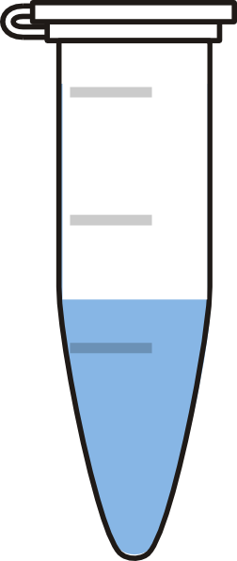
Typically we do not capture all of the within host diversity of an infection. Rather, we summarize that diversity with consensus genomes.
Within host diversity over an infection.
Diverse population of viruses sampled within a specimen.
Single sequence summarizes the diversity.

Slide 16
The changes that we observe in consensus genomes reflect additional processes beyond mutation.
In nature
Actual errors made during the replication cycle.
In our data
The changes to consensus sequences that we observe at the population level.
Notes:
The fraction of mutations that accumulate and are detectable at the consensus level as substitutions depends on: the mutation rate, the size of the genome, the duration of an infection or the time until transmission, the fraction of mutations that persist and spread and the time scale over which you sample.

Slide 17
If this is the process that is occurring in nature...

Slide 18
This is the process that we would see recorded in the data if we sequenced every case.
Notes:
Two major things that you can observe about the transmission process from this divergence data: 1) as transmission is occurring you get increasing diversity. In this way diversity provides a proxy for the size of the outbreak, with more infections and larger outbreaks yielding greater levels of genetic diversity. The other is that closely related infections will generally have identical or only minimally diverged genome sequences, because minimal time for substitutions to accrue separates those genomes.

Slide 19
And this is typically what we observe, because only a fraction of people are sampled

Slide 20
Closely-linked cases have genetically similar infections.
Distally-related cases have more genetically dissimilar infections.

Slide 21

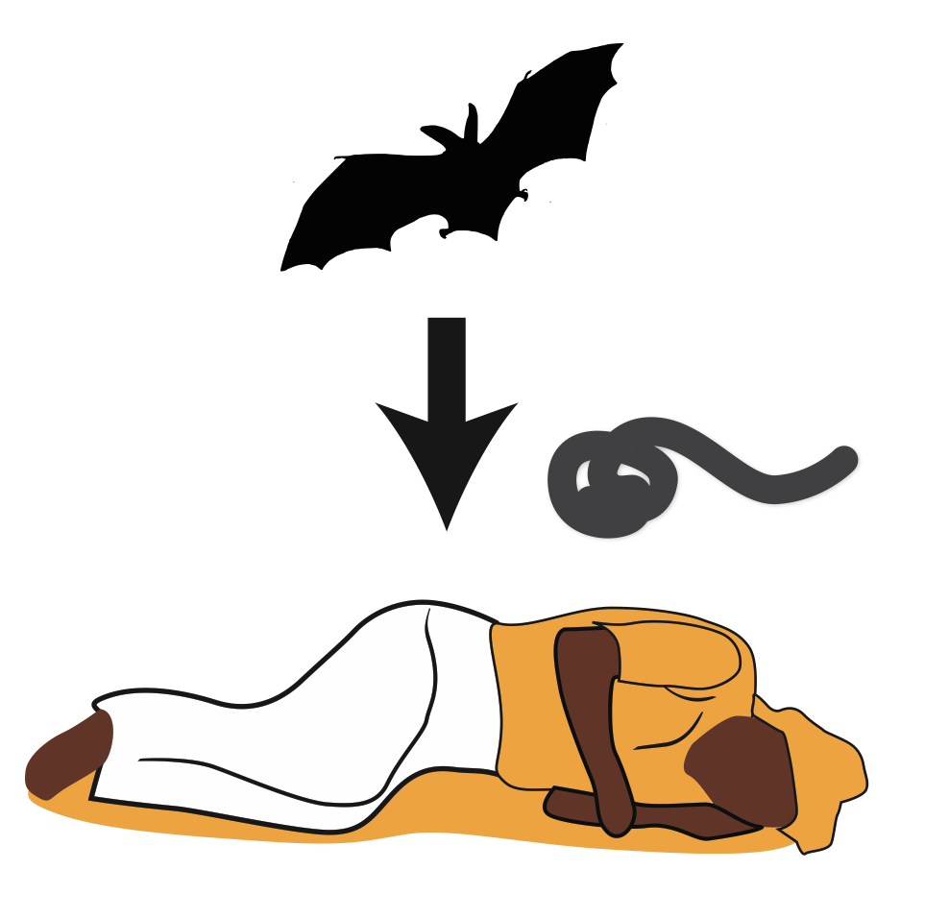
Why use genomic epidemiology?
What is the pathogen?
What is the reservoir?
How many introductions from reservoir?
1. Identify the origin of epidemics/zoonoses

Slide 22
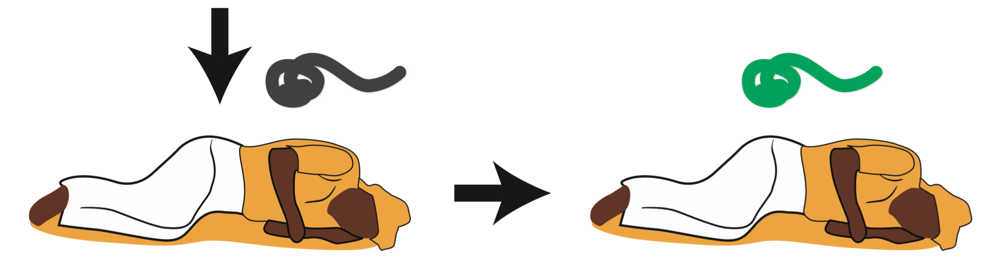
Why use genomic epidemiology?
2. Understand transmission dynamics
Are cases linked to one another?
Is there evidence for human-to-human transmission?
When did the pathogen enter the population of interest?
From where was it introduced?
How is the pathogen evolving as it spreads?

Slide 23
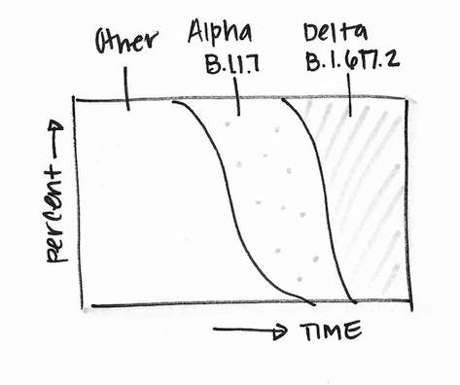
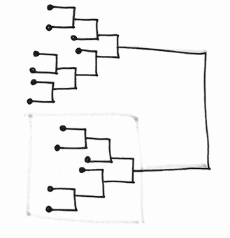
What variants are circulating in my community?
How are variant frequencies changing?
Are these cases linked?
Where is transmission occurring?
Are my interventions working?
Indicator-based Surveillance
Outbreak Investigations

Slide 24
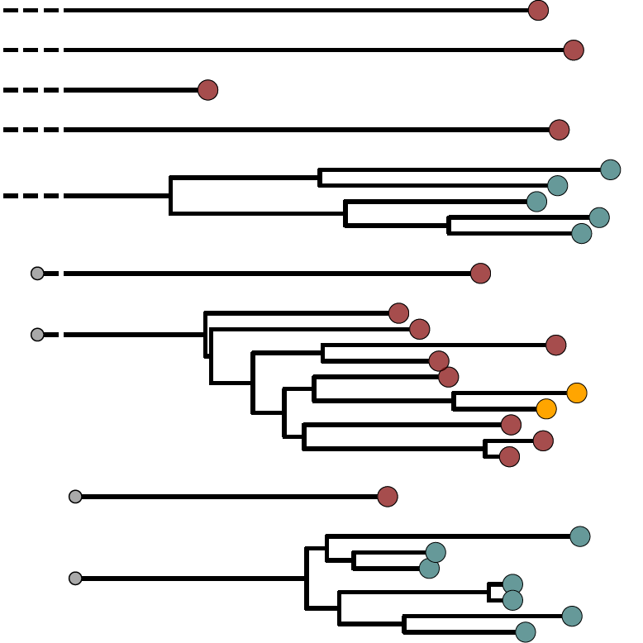
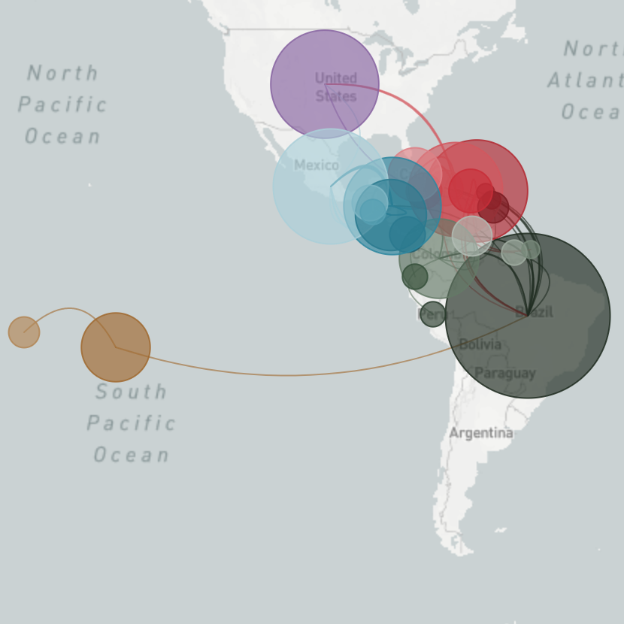

We can use genomic data and phylogenetic analyses to describe many aspects of transmission
Introductions and onward transmission
Spatial patterns and source-sink dynamics
Emergence of adaptive variants

Slide 25
Application - Describing patterns of introduction and spread.

Slide 26

Notes:
Epidemics spread similarly to fires...you have sparks that “introduce” fire into a new area...and that fire can take off and really burn or not. Where the spark lands governs that process. Differentiating separate introductions is really hard to do simply from case data.

Slide 27
Phylogenies can help us visualize the sparks/introductions and the burn/spread.
Notes:
Epidemics spread similarly to fires...you have sparks that “introduce” fire into a new area...and that fire can take off and really burn or not. Where the spark lands governs that process. Differentiating separate introductions is really hard to do simply from case data.

Slide 28
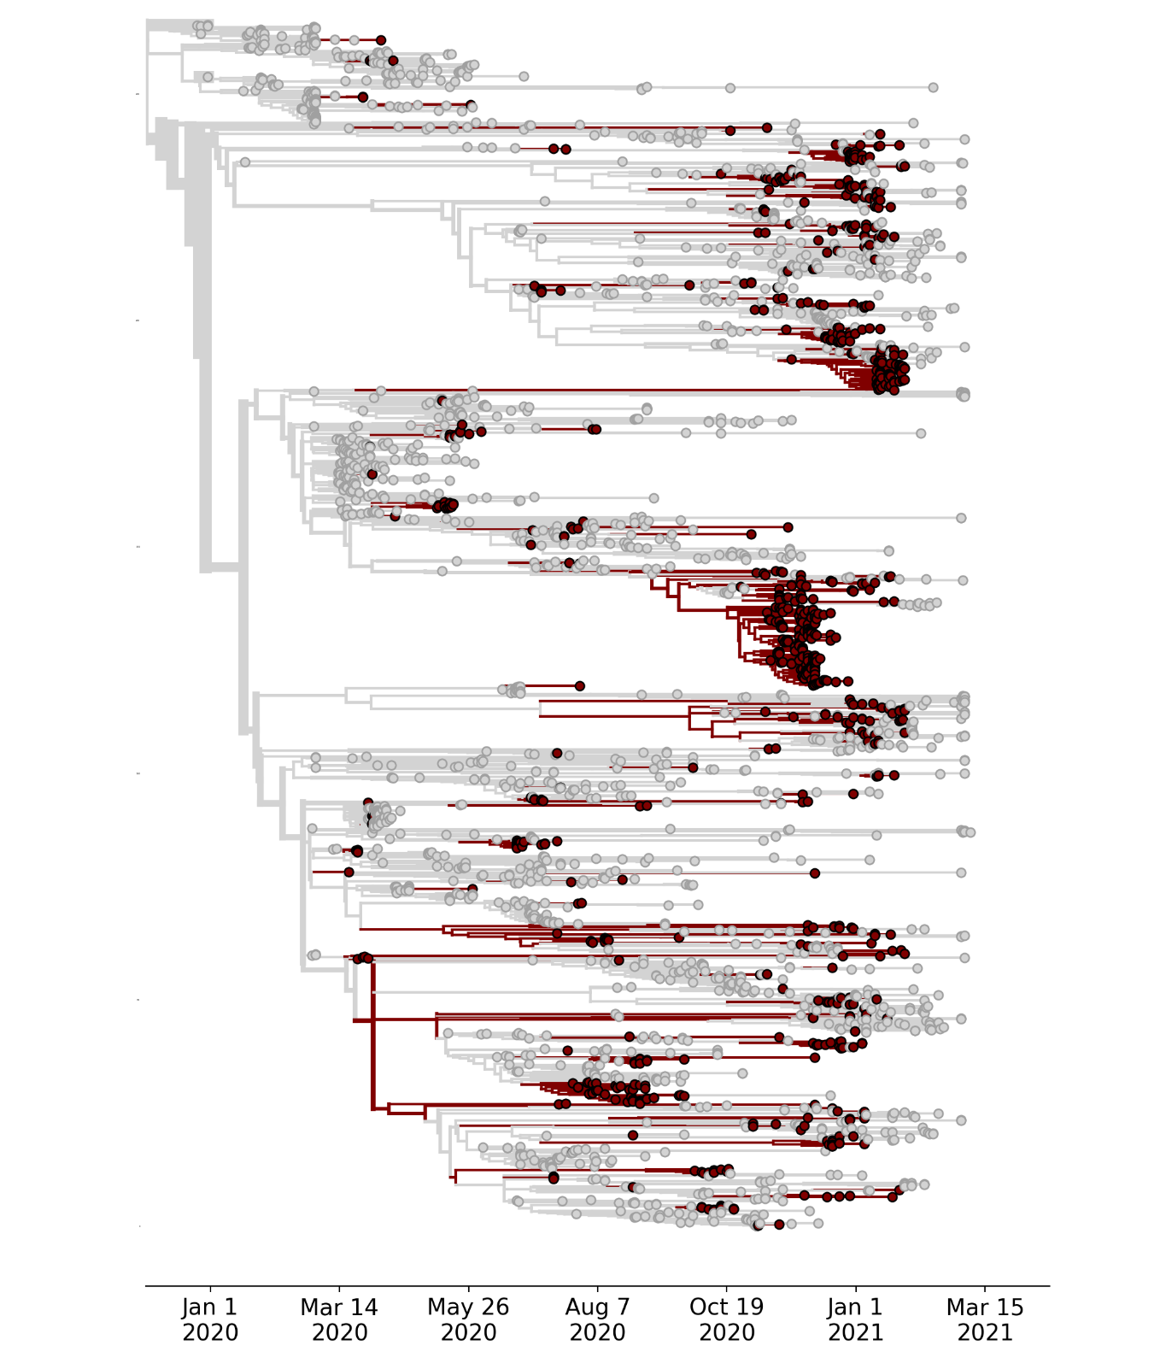
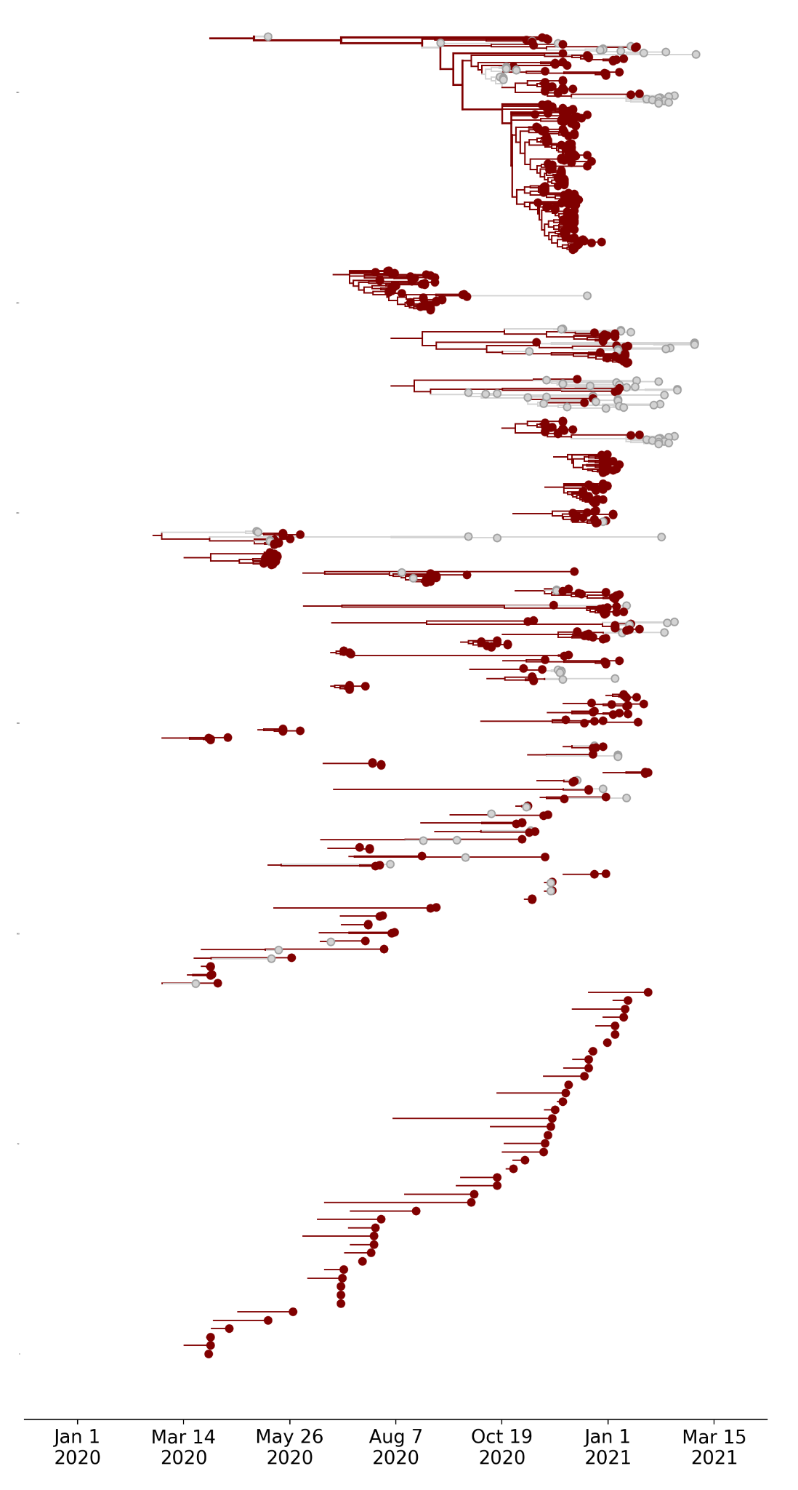
Example: separating the tree into its distinct transmission chains.
Stoddard, Black et al, 2022

Slide 29
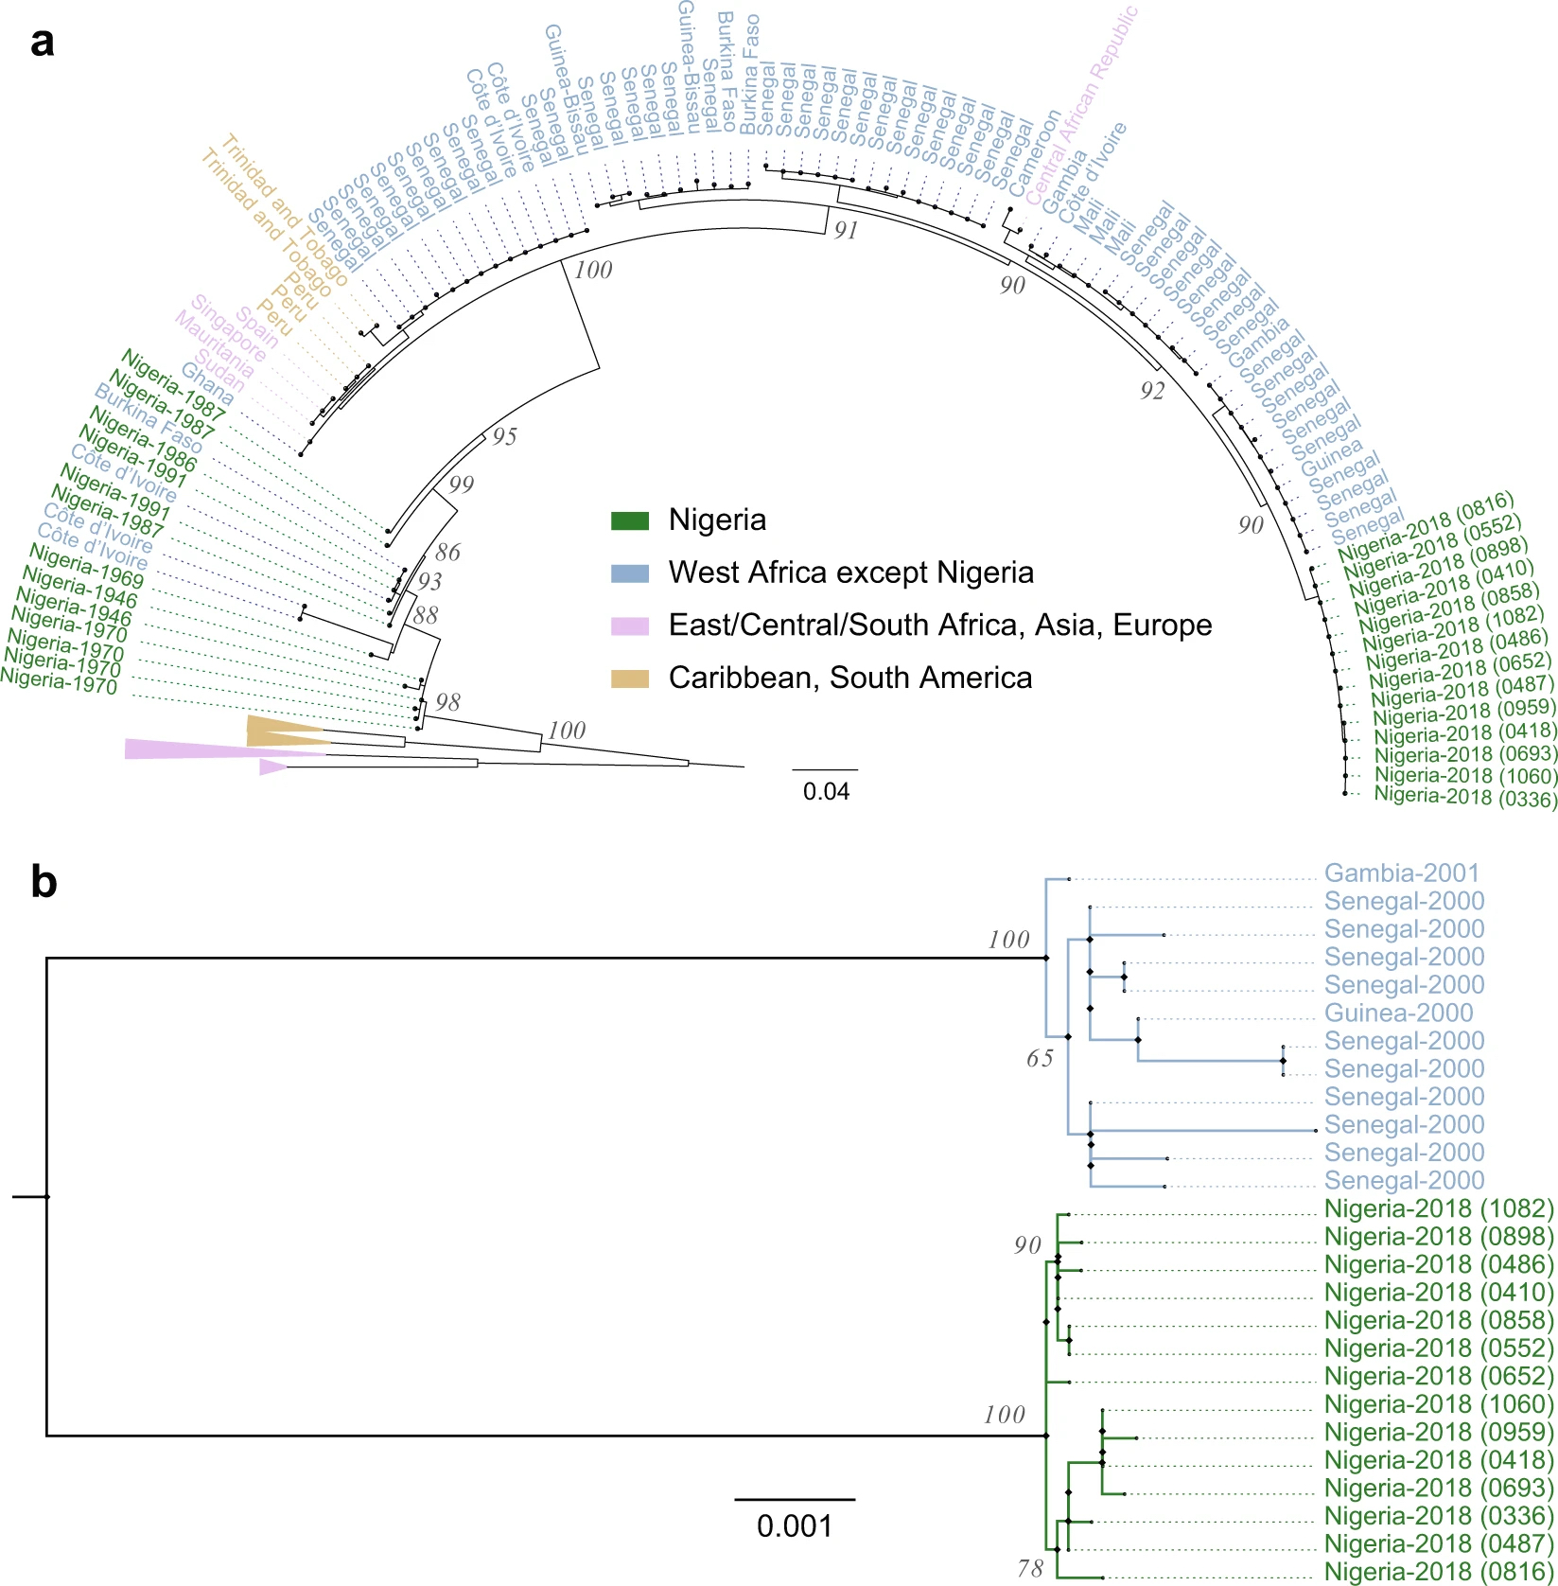
Genomic Epidemiology of a Yellow fever Outbreak in Nigeria
2018 YFV sequences formed a tightly clustered clade.
The 2018 clade was more closely related to sequences from other West African countries (mean pairwise identity = 99·4%) than to earlier (1946–1991) Nigerian sequences (mean pairwise identity = 89·8%).
Ajogbasile et al., 2020

Slide 30
Application - Exploring linkage between cases and/or outbreaks.

Slide 31
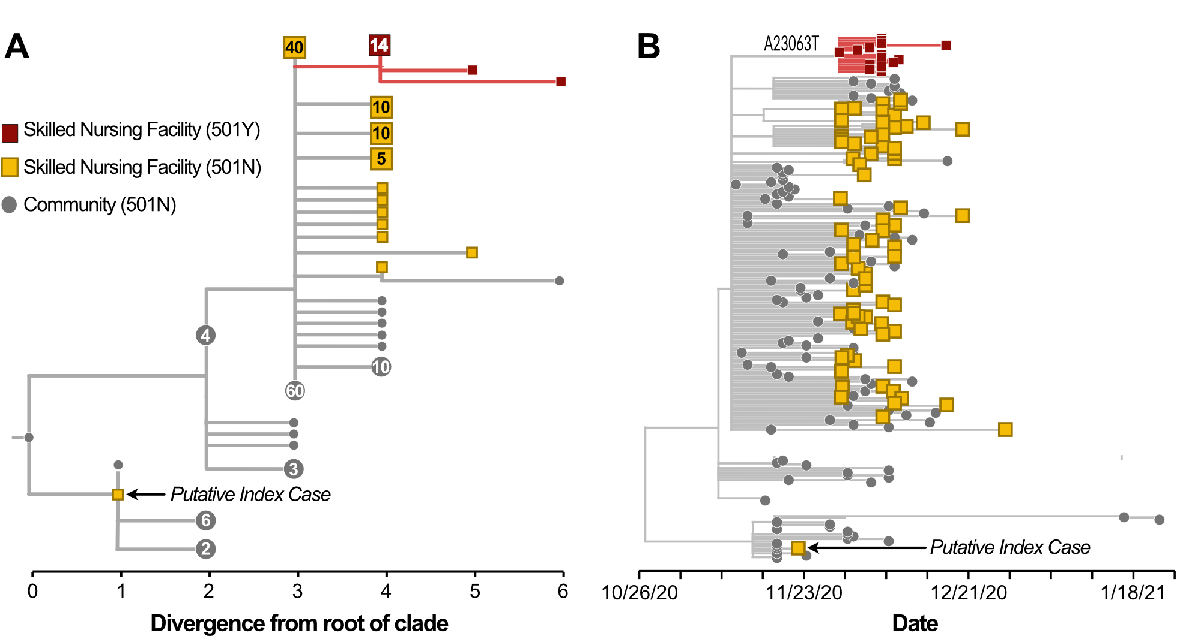
Genomics can also rule out linkage between cases.
Stoddard, Black et al, 2022
Notes:
Putative index case was a staff member at the SNF and tested positive one week prior to the first resident cases...but their case is actually genetically diverged from the resident cases...this person wasn’t the source of that outbreak (remember what we said about genetically diverged cases usually being more distally related).

Slide 32
Application - Monitoring for the emergence of adaptive variants.

Slide 33
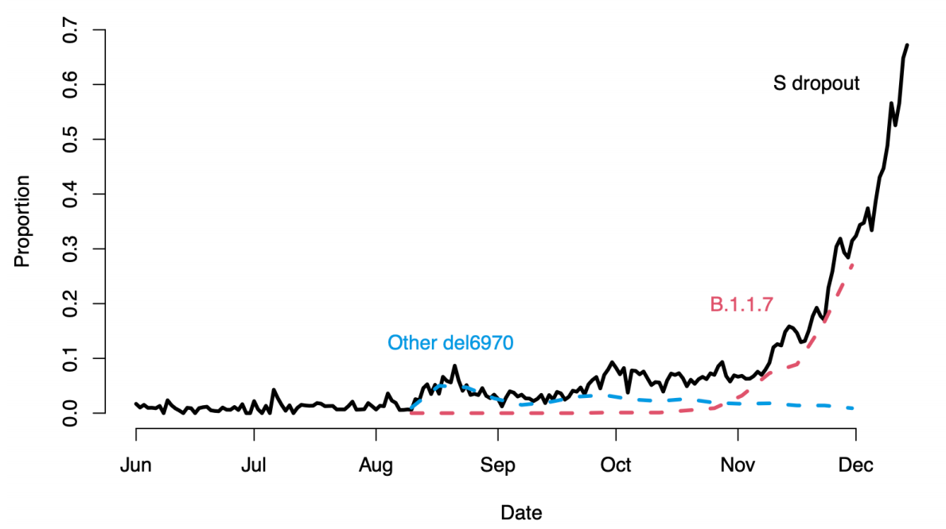
Using lineage frequency change to monitor for emergence of adaptive variants.
PHE, 2020

Slide 34
Surveillance for mutations of interest can go beyond monitoring VOC frequency.
Stoddard, Black et al, 2022

Slide 35
Application - Describing spatial dissemination of infectious diseases.

Slide 36
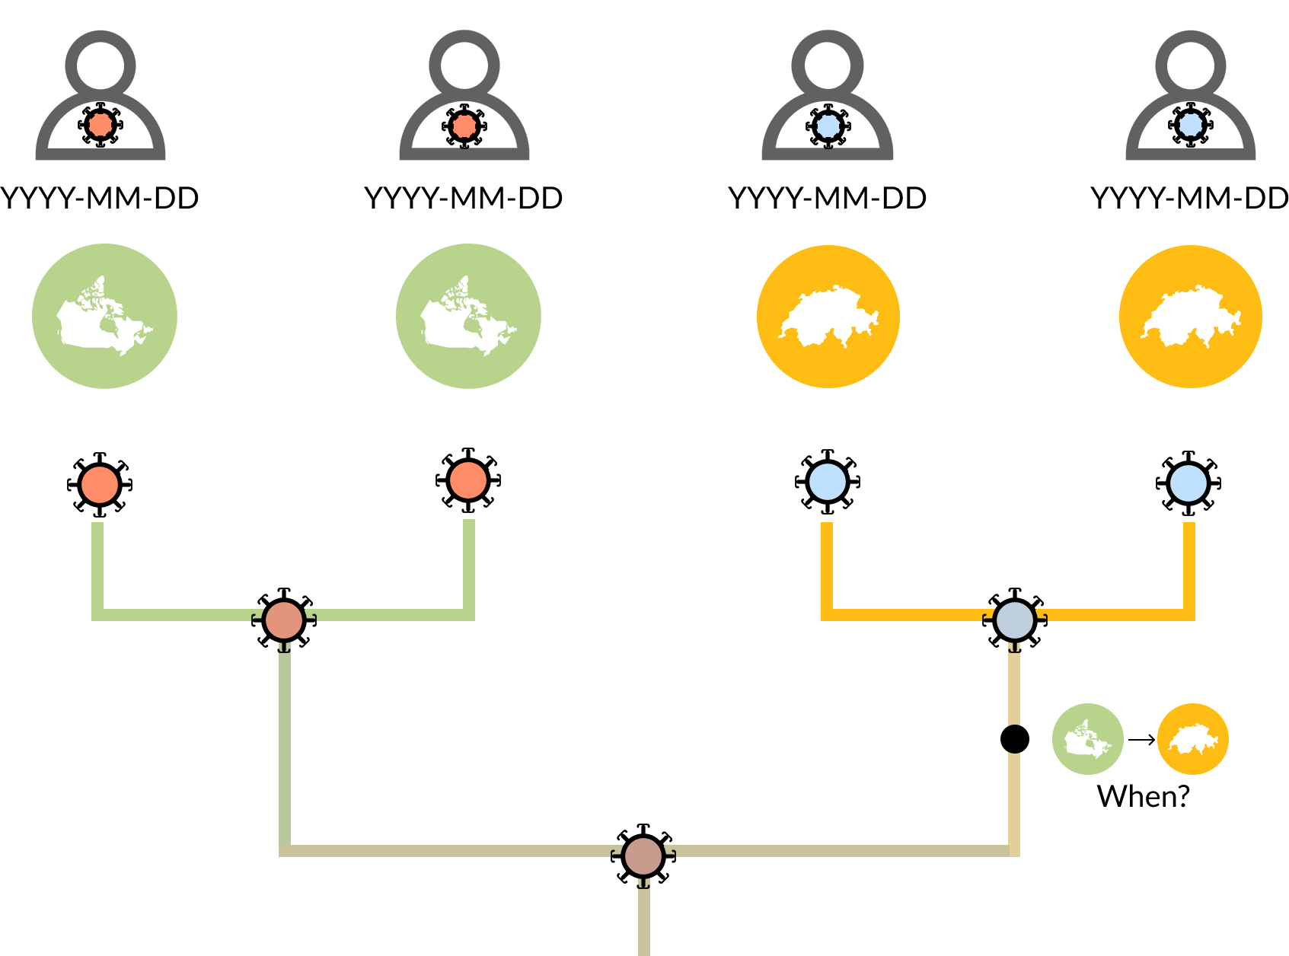
Incorporating “metadata” allows us to scale phylogenies in terms of time and look at geographic transmission patterns.

Slide 37
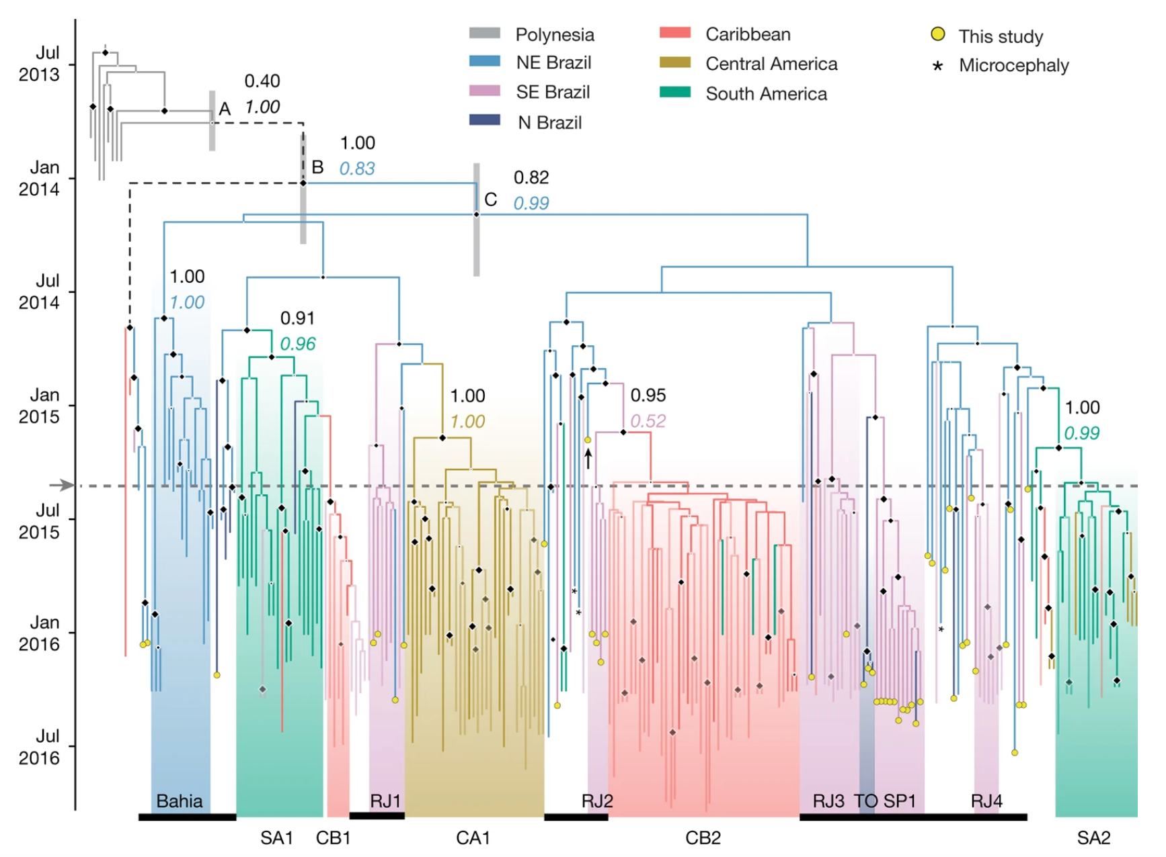
Example: estimating when Zika was introduced to Brazil, and where it went from there.
Faria et al, 2017

Slide 38
Application - Animal-to-human spillover events.

Slide 39
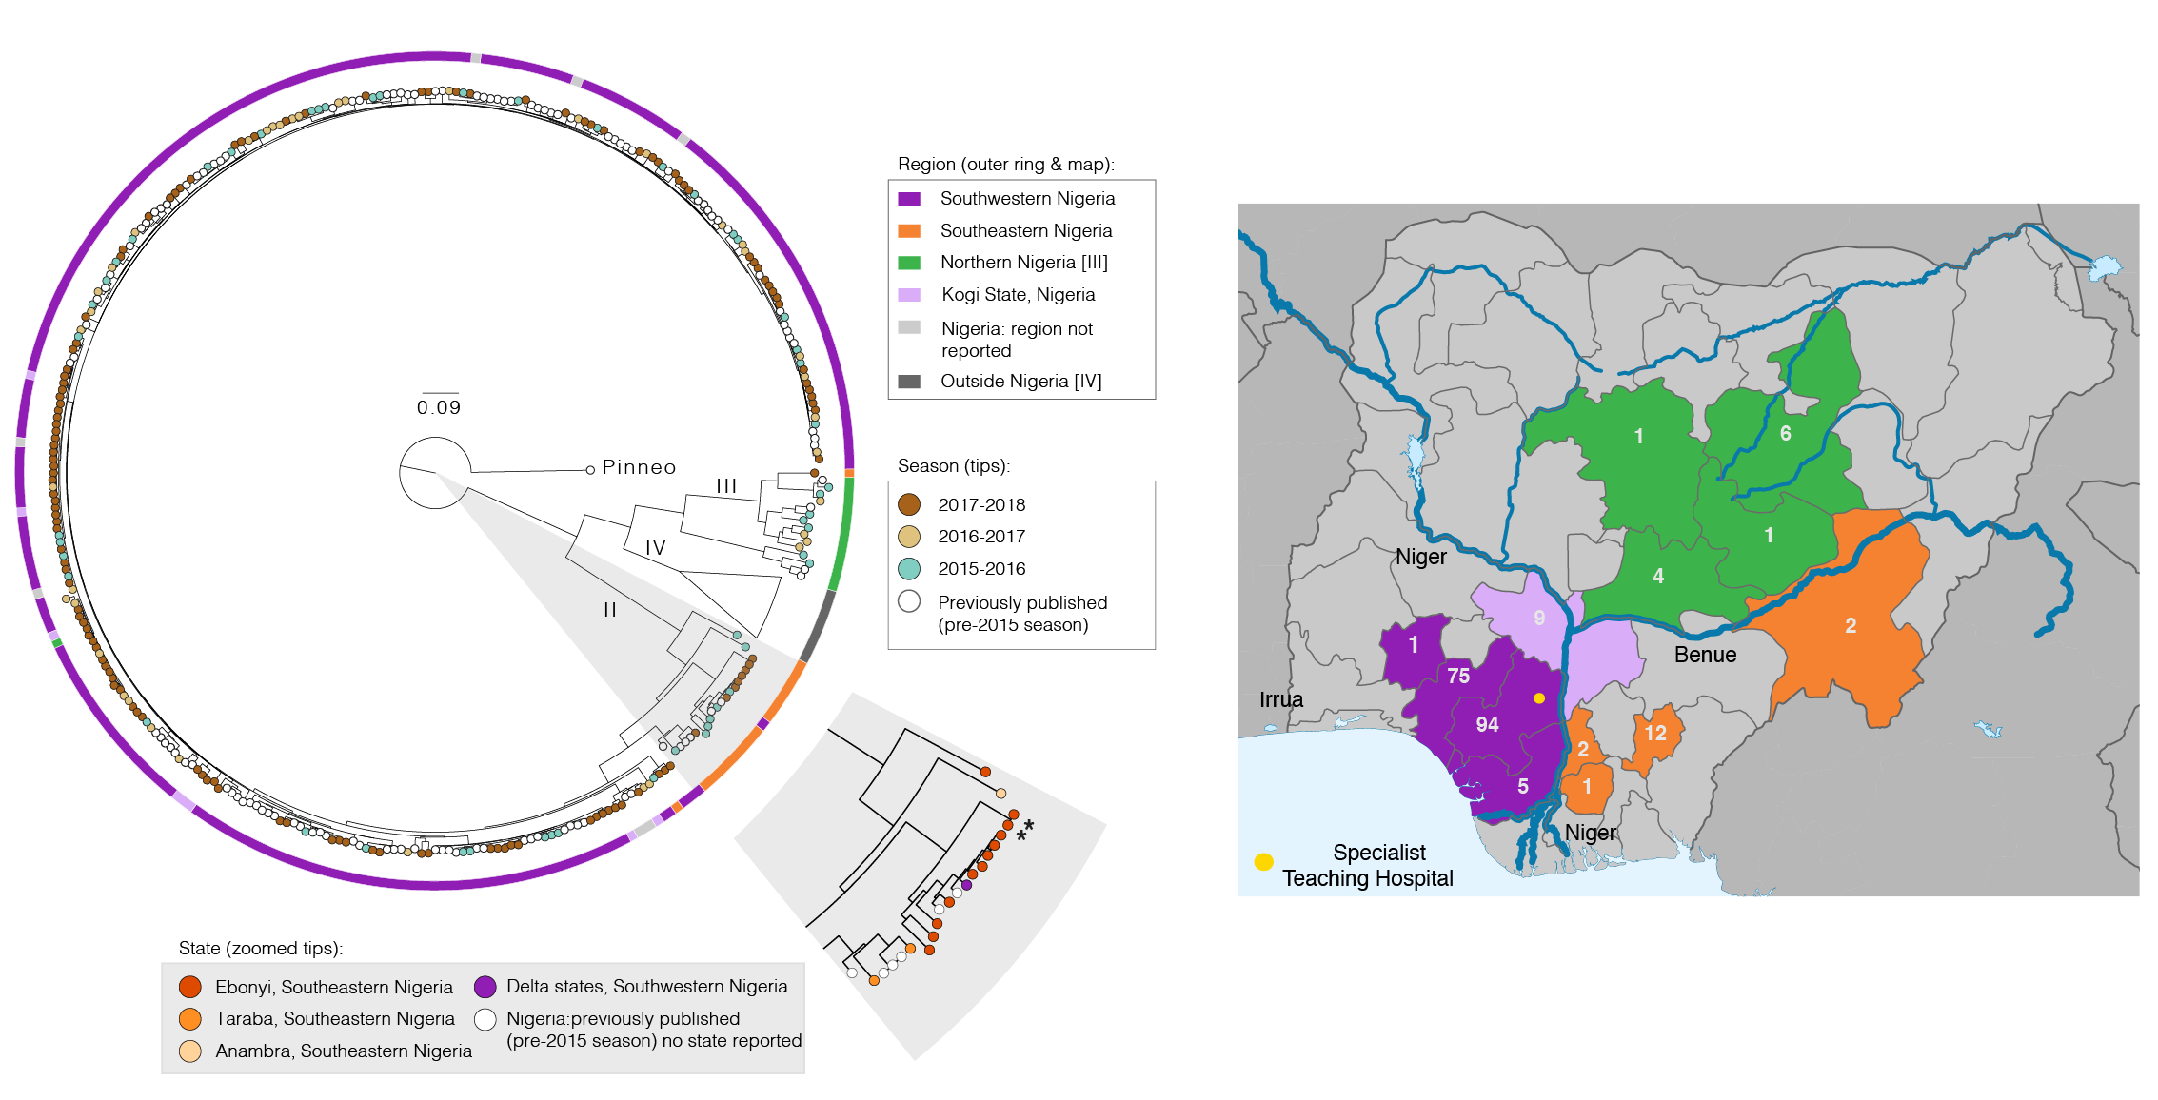
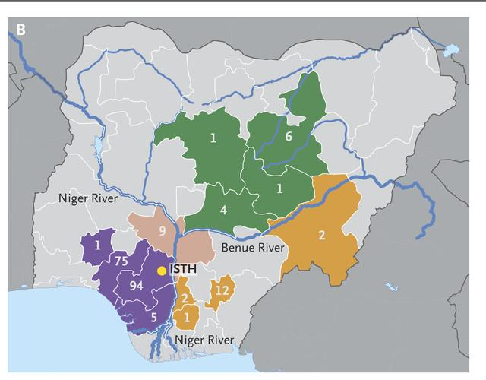
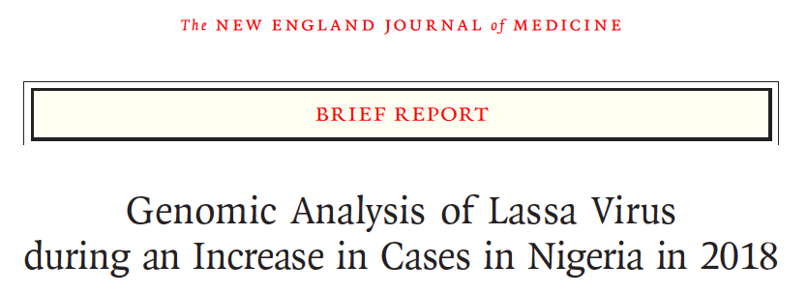
Genomic Epidemiology improves understanding of Lassa virus populations across Nigeria
Siddle et al., 2018
Lassa virus genetic diversity in Nigeria is structured geographically, following major rivers

Slide 40
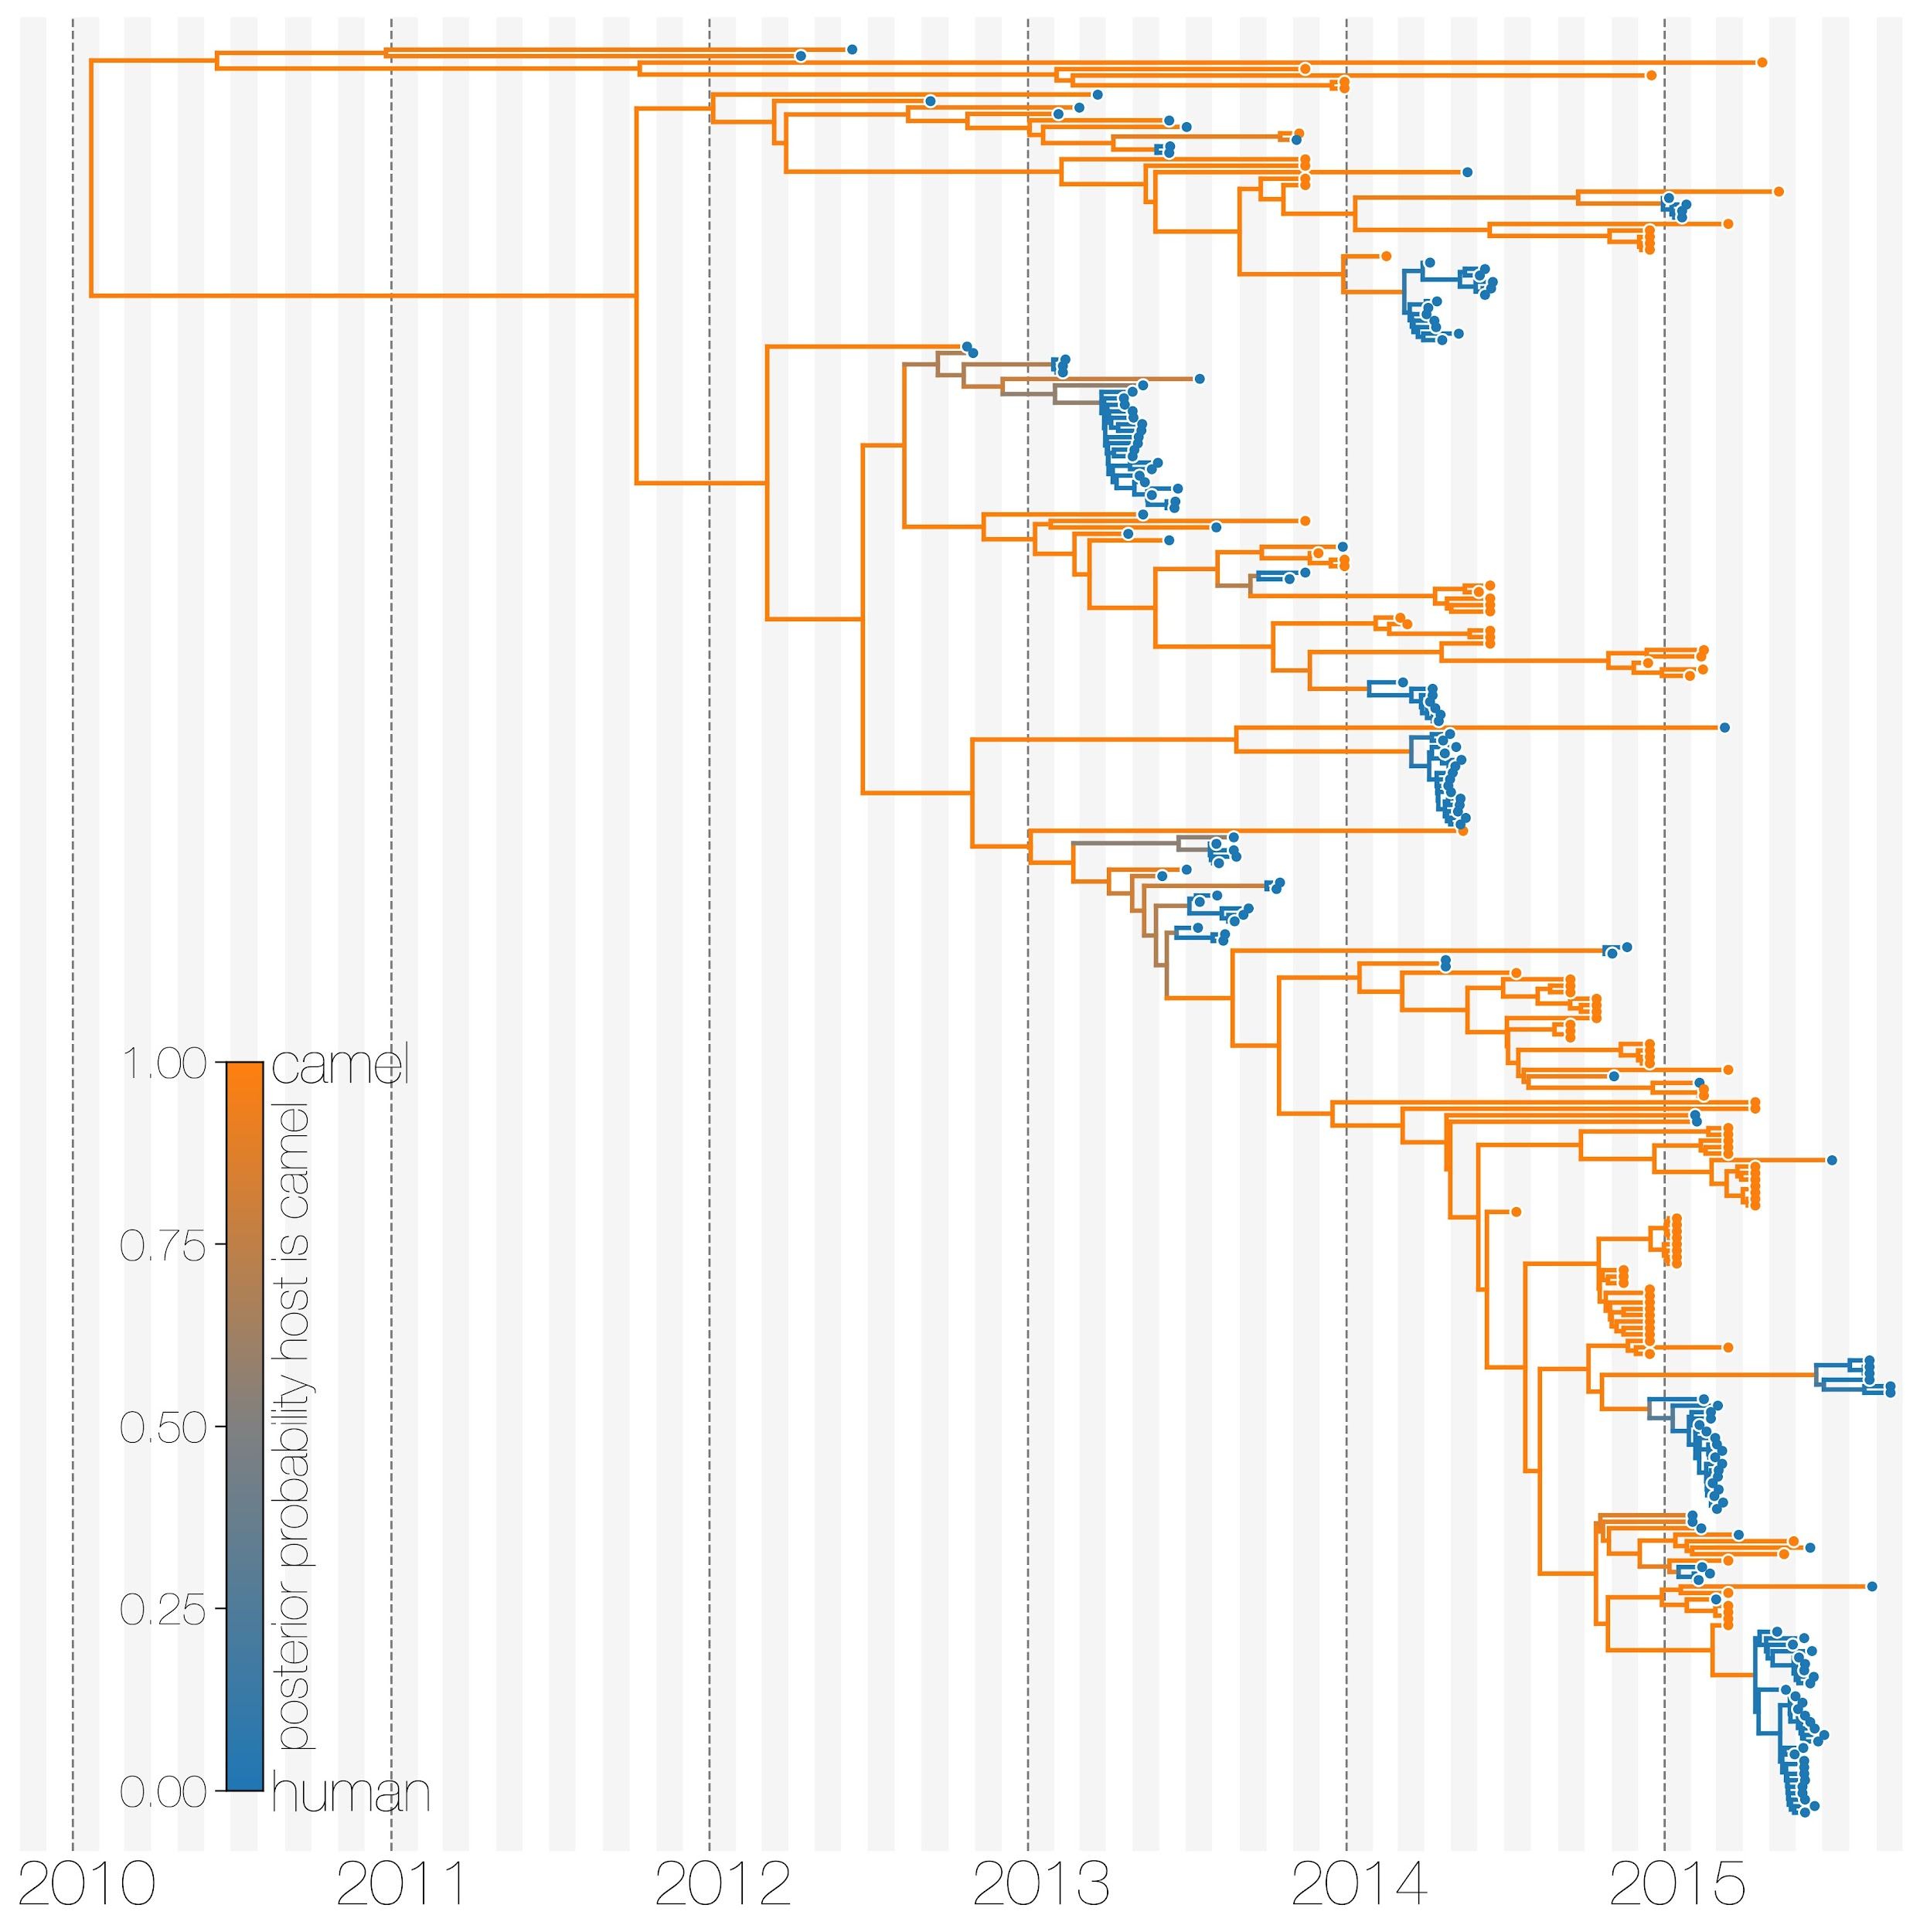
MERS camel-to-human spillover events
(Dudas et al, 2018).
Notes:
You can correct for these issues with more specialized evolutionary models that we can totally talk about at a later date if people are interested!

Slide 41
Genomic epidemiology can inform public health action.
Helping us understand the contributions of different epidemic processes to outbreaks.
Investigating possible linkages between cases.
Evaluating how well our interventions are performing.
Notes:
Contributions: allowing us to tailor interventions and focus where biggest problems are:
Linkages: validating contact tracing inferences, and highlighting possible discrepancies or unreported exposures.
Evaluations: get critical feedback on how well our response efforts are working!

Slide 42
Questions?

